Slide 1
Improving our Course Development and Alignment with Course Mapping
Anthony Piña, Ken Moran and Barry Sanford

Slide 2
Professional Development Goals
Assess PD needs
Please complete the survey!
Provide variety of PD opportunities
Calendar of PD opportunities
Need info on professional associations, conferences & certifications
Recognize faculty activities
Professional development
Scholarly activities

Slide 3
Objectives for this session
Discuss advantages and challenges of current course development processes
Discuss the benefits of college-level and course-level mapping

Slide 4
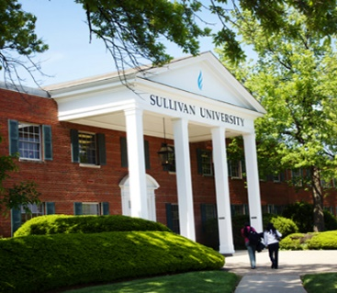
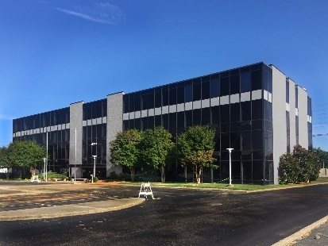
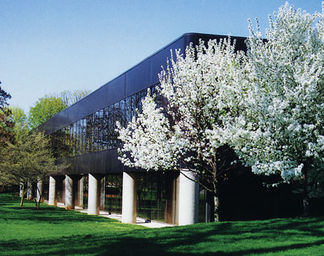
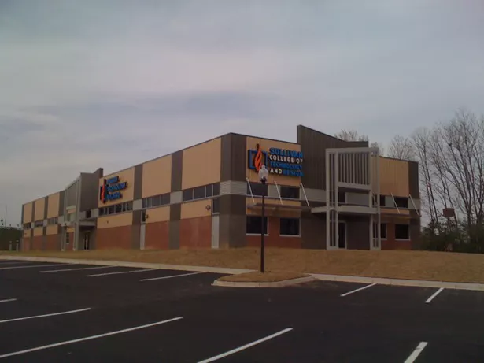
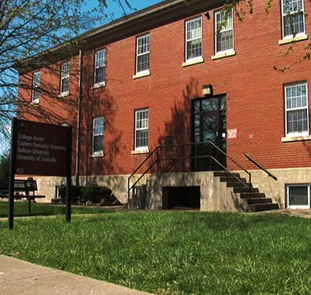
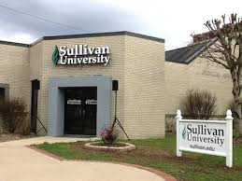
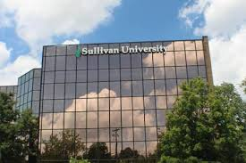
How will our merged future be?

Slide 5
“The institution places primary responsibility for the content, quality and effectiveness of the curriculum with its faculty.”
-- Principles of Accreditation 10.4 (2017)

Slide 6
Roles
Academic Unit
Determines content to be taught (curriculum)
Instructional Design
Performs “heavy lifting” of course development
Combines expertise of instructional designers with that of the subject matter experts
Academic Unit
Evaluates quality and effectiveness and approves course

Slide 7
It has too often been the case…
University Mission
Program Mission
Program-Level
Outcomes
Assessment of Program Outcomes
Course #1
Course #3
Course #4
Course #2

Slide 8
“Bottom up” approach (SU Online)
Measurable Outcomes
Align Outcomes & Assessments
Quality Standards
Consistent Across Modalities

Slide 9
Accreditation & regulatory bodies
Measurable Outcomes
Align Outcomes & Assessments
Quality Standards
Consistent Across Modalities

Slide 10
Filling the gap
Accreditation and Regulatory Bodies (top down)
Curriculum Committee
Program Outcomes
3-year course review
PECC & Assessment
F2F Course Development
Online Course Development
Course Development (bottom up)

Slide 11
Goal is alignment
Accreditation and Regulatory Bodies (top down)
Program Outcomes
PECC & Assessment
F2F/OL Course Development
Curriculum Committee
3-year course review
Course Development (bottom up)

Slide 12
Reach the goal
By making a change in the course development process we can facilitate alignment

Slide 13
How it started: COBA OER Pilot
Expected
Students saved money
Students rated OER courses higher
Students rated OER materials as better
Students likely to enroll in OER institutions
Faculty felt more liberated
Unexpected
Course design process improved
Faculty SME and IDs relationship improved
Course maps were key!

Slide 14
Course map
Course blueprint/architectural document
Specifies course and weekly objectives, assessments & content
Guides the development of the course

Slide 15
Current course development
Academic Unit (Dean)
Determines need & selects SME
Requests course development
Evaluates and approves course
SME and ID
Completion of course map
Course objectives and major assessment
Weekly objectives, assignments and content
SME selects, vets & creates course content
ID assures content meets standards & requests payment

Slide 16
New course development
Academic Unit (Dean)
Determines need & selects SME
Completion of Program-to-Course Map
Course objectives and major assessment
Emphases and requirements of course
Requests course development
Evaluates and approves course
SME and ID
Completion of course map
Course objectives and major assessment
Weekly objectives, assignments and content
SME selects, vets & creates course content
ID assures content meets standards & requests payment

Slide 17
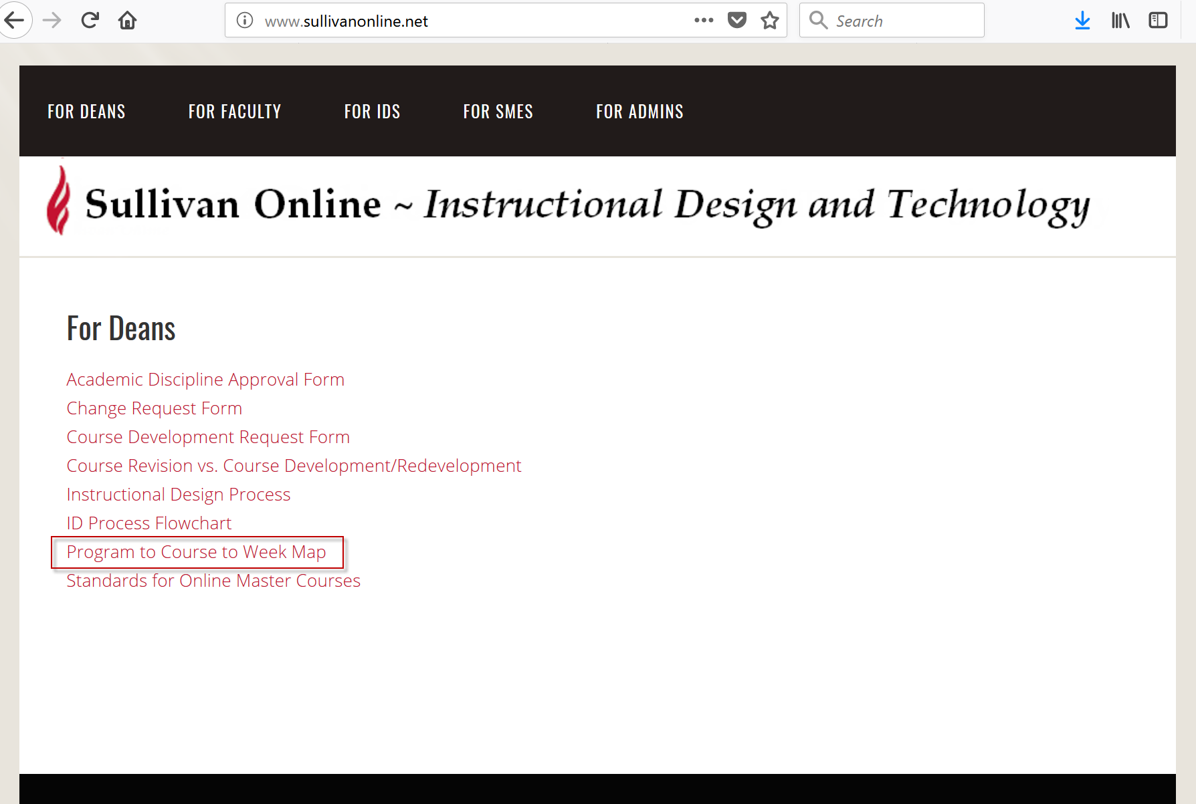
www.sullivanonline.net

Slide 18
Program-to-course map (Dean)
First part of Course Map
Program outcomes/assessment assigned to course
Levels of learning outcomes (Bloom’s)
Course objectives linked to program outcomes
Dean’s guidance for assignments (if applicable)
Required materials (if applicable)
Faculty qualifications

Slide 19
Weekly course map (SME & ID)
Second part of Course Map
Weekly objectives (tied to course objectives)
How will you teach to the objective?
How will you assess this objective”
Grading criteria
Assignment descriptions

Slide 20
Making it work
Best done with deans and lead faculty
Lead faculty may or may not be the SME
Course map completed prior to course development
Goals
A course map for every course in the catalog
Use course map for F2F course development
Drs. Piña & Moran & IDs will work with Deans

Slide 21
Our merged future
University Mission
Program Mission
Program
Outcomes
Assessment of Program Outcomes
Mapping
Course-Level Objectives
Assessment of Course-Level Objectives

Slide 22
Benefits
Accreditation and Regulatory Bodies (top down)
Program Outcomes
PECC & Assessment
F2F/OL Course Development
Curriculum Committee
3-year course review
Course Development (bottom up)

Slide 23
Benefits
Aligns course objectives, assessments to program
Academic Unit “owns” course
Assures that Dean’s wishes are met
Eliminates “stray” courses
1st & 2nd parts of course map can be used by Deans
Accreditation evidence (SACSCOC and Programmatic)
PECC
Curriculum Committee
3-year course evaluation/update
Collaboration on courses shared with other programs
Development of online, hybrid and F2F courses

Slide 24
How will our merged future be?

Slide 25
Questions

