Slide 1
How to Make Handouts Compliant
Features to Use Within Native Programs to Ensure Accessibility

Slide 2
Microsoft Word Documents
Use headers rather than formatting manually
Start with Heading 1 as topmost defined heading
Do not skip Headings
Use Table of Content for complex documents
Use a san serif font
Body text 10-12 pt
Line and a half spacing
Line length (?)
Notes:
Headings styles would be decided by us and then we need to set them up as quick styles in our version of Word so they can be used for handouts.
Headings for content to be copied/pasted in Blackboard are a different process/case

Slide 3
Images in Word Documents
Use Alt Text tags for all images
Short for most images
Include relevant words if graphic uses words
Null “” for pictures that are not specifically relevant/decoration only
Do one of these for complex graphics
Add long description
Add explanation in a doc of ‘explanations’ as alternate presentation
Explain above/below the graphic within main document

Slide 4
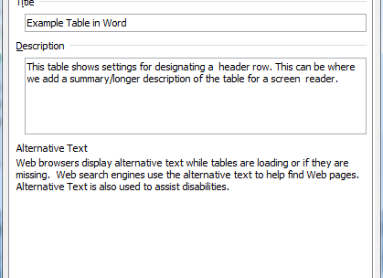
Tables in Word Documents
Introduce with text explanation of table
If possible spell out numbers in explanation
Use Summary/Alt text
Avoid using empty chunk

Slide 5
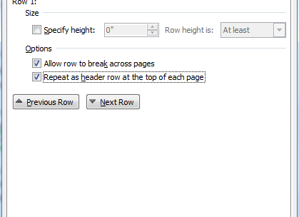
Table Headings in Word
Designate header - first row for column headings
Repeat across pages
Use heading style for row and column heading text

Slide 6
Best file format and accessibility checker
.doc and .docx may work best with readers
.rtf retains most features and works with assistive tech
Avoid .txt
Use accessibility checker
File>Check for Issues>Check Accessibility

Slide 7
Creating Accessible Powerpoint Presentations
Use slide templates, already accessible to readers
E.g., ‘Two columns slide’ when you need columns
Use simplest layout to convey relationship
Ensure all slides have unique titles
Use legible type, sans serif
Font size never less than 12 pt
Avoid excessive brevity
6 by 6 rule may lead to removing words to fit

Slide 8
Checking Contrast in PPT
Dark type on a light background or vice versa best
Do not rely on designs as they are
What do you see here? Is this a good design as is?
Use adequate white space

Slide 9
Bells and Whistles – To Use or Not to Use that is the question
Do not use features just because they are there
Use them to draw attention or keep focus if warranted
Best practice is to avoid
Added text boxes
Animations (can cause readers to crash)
Slide transitions
Automatic timing (let reader decide pace)
Hyperlinks/buttons (do not work with readers)

Slide 10
Audio Issues in Powerpoint
Screen readers can read/vocalize text on slides including alt text for images
Audio narration…not so much
Thoroughly discuss slides content/words in the narration
Provide transcript of the narration/actual script of words
Work around is to put these into ‘Notes’ and save/link to a version as handout (not just saving as slide show)
Use the Link Narration box

Slide 11
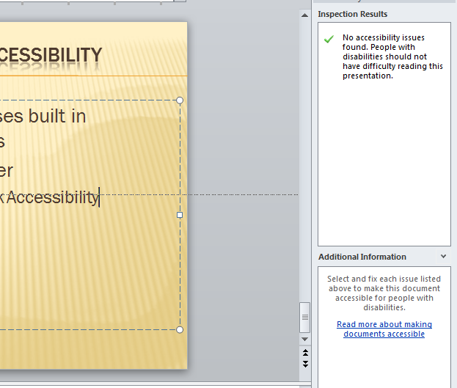
Best file formats and Accessibility Checker
.ppt and .pptx work if ppt uses built in accessible features and tips
Use the Accessibility Checker
File>Check for Issues>Check Accessibility

Slide 12
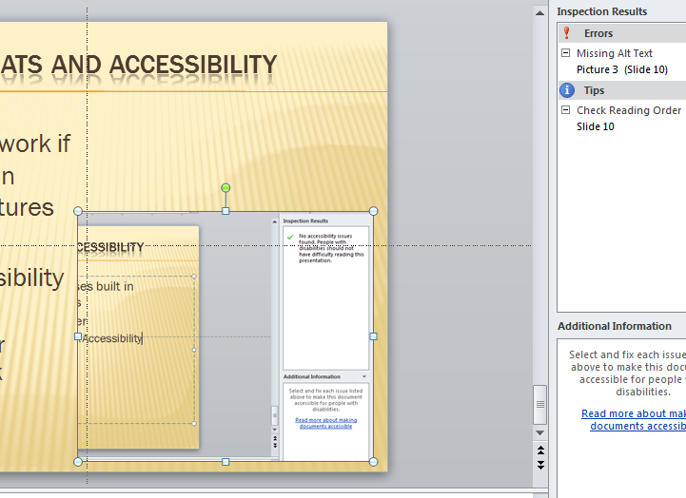
Report showing errors
In Slide 10 I did not choose a template that included a graphic - I just inserted one without alt text …and created an error

Slide 13
PDF Accessibility Issues
Some pdfs are black boxes to readers
Scanning a doc to pdf
Creates a picture of the document/not readable
Can check to run optical character recognition (OCR) but is not perfect
If creating in Word/Adobe must check the item that makes doc accessible to reader software

Slide 14
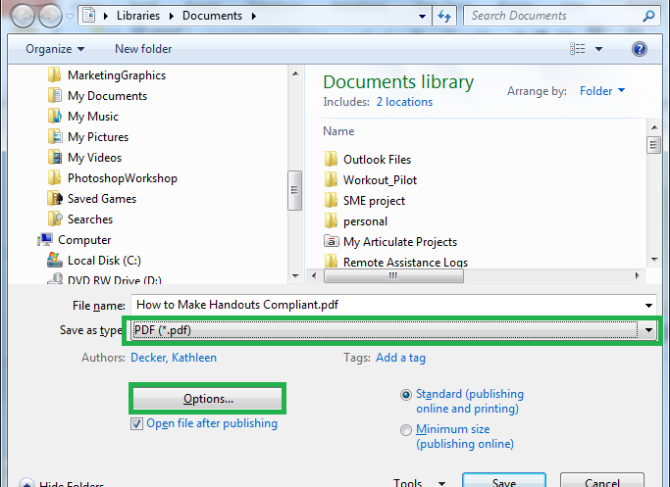
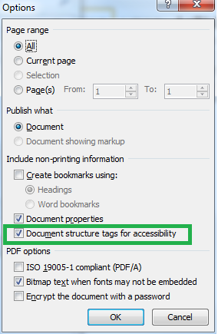
Save PDF in word steps
Select pdf
Go to Options
Check accessibility

Slide 15
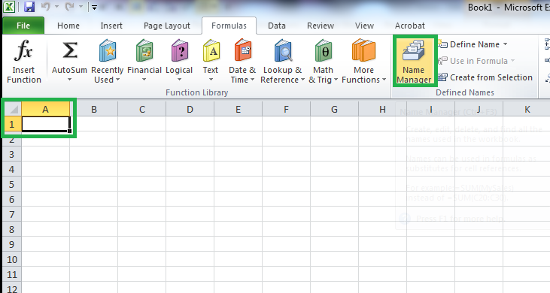
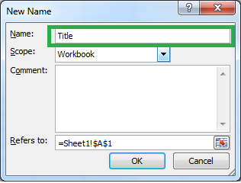
Excel Spreadsheets
Interfaces with readers well
Tag first cell as Title
It then knows this is the row and column titles

